Slide 1


Data Integrity Management
for
Government Programs
A powerful solution for government agencies struggling with data quality and validation challenges.

Slide 2




Data Integrity Challenges
Government programs face critical data quality issues that threaten program integrity and service delivery:
Duplicate Records
Data Inconsistency
Manual Bottlenecks
Multiple entries for the same beneficiary across databases, leading to redundant services and wasted resources
Variations in names, birthdates, and addresses making it difficult to verify eligibility and track services
Staff spending hours on manual validation, delaying service delivery and program implementation
These challenges create significant operational inefficiencies and increase the risk of improper payments and fraud.

Slide 3
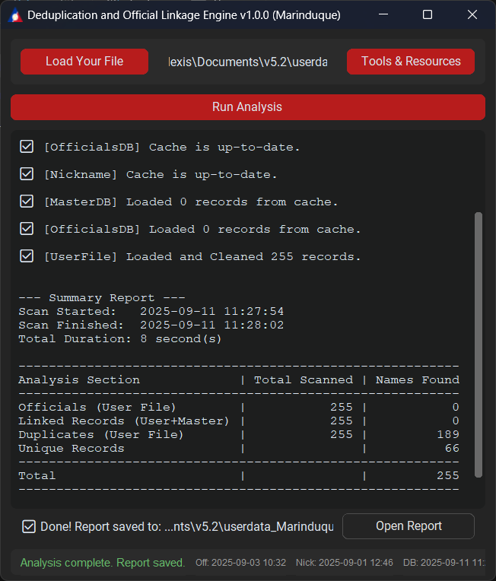

Introducing DOLE v1.0.0
Deduplication and Official Linkage Engine
A comprehensive solution designed specifically for government data quality teams:
Automatically identifies duplicates using advanced matching algorithms
Links and validates records against official master databases
Generates standardized reports for compliance and decision-making
Includes dedicated Auditor Tool for suspicious match review

Slide 4
Core Capabilities
1
2
High-Accuracy Matching
Excel Dashboard + PDF Export
Advanced algorithms detect nicknames, phonetic variations, and spelling differences with 98.7% accuracy in government datasets
Familiar interface requires minimal training with color-coded results and confidence scores
Example: Recognizes "William Smith," "Bill Smith," and "Wiliam Smyth" as potential matches
Generate professional PDF reports for stakeholders and audit requirements
3
4
Specialized Auditor Tool
Portable & No Installation
Deep-dive into suspicious matches with side-by-side comparison views
USB-ready application works immediately on standard government workstations
Track decision history and maintain detailed audit logs for compliance
No IT department involvement or admin rights required for deployment

Slide 5

Security & Compliance
Designed with government requirements in mind
100% Offline Operation
Zero Data Storage
Works completely disconnected from networks, making it suitable for sensitive data environments
Processes data in memory only - no permanent records retained after session ends
Minimal System Requirements
Compatible with standard government Windows PCs, including legacy systems
Compliant with Data Privacy handling requirements

